Slide 1

What makes movies to be successfull?
Oz Cohen
Yehonatan Cohen

Slide 2

Who Does not like to watch a good movie ?
How can we tell what it is a good movie?
Is there connection between runtime on its success?
Is there an effect of budget on its success?
Is there an effect of revenue on its success?
Is there an effect of popularity in it on its success?
Moreover, we will check which algorithm give as the best result?

Slide 3
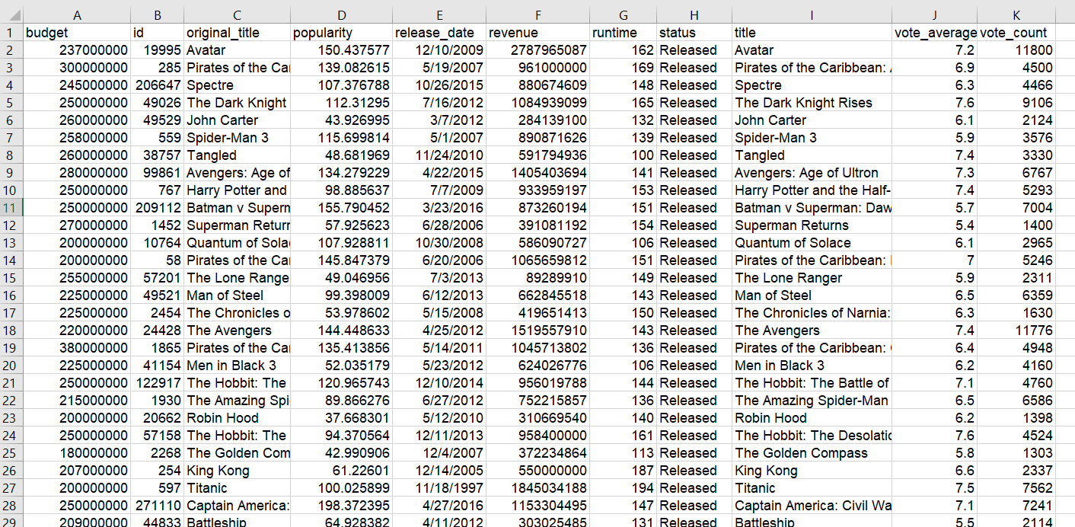
The classification for each question was performed as follows:
For run time - a movie with 130 min of runtime or more will be defined as successful otherwise unsuccessful.
For revenue - a movie with revenue of 90,000,000 or more will be defined as successful otherwise unsuccessful.
For budget - a movie with a budget of 40,000,000 or more will be defined as successful otherwise as unsuccessful.
For popularity - a movie with a popularity of 30 or more will be defined as successful otherwise unsuccessful.
For revenue & vote average – a movie with revenue above of 72,000,000 and vote average with at least 6.5 will be defined as successful otherwise unsuccessful Source of the database: Click

Slide 4

Challenges
We initially worked on a database of IMDB's top 1000 movies and realized that the database was too small, so we switched to another database which contains 5000 movies.
In the code as you can see, we have downloaded the irrelevant columns since they contain non-measurable information.
In addition, when we ran the code, we got the error
"ValueError: Input contains NaN, infinity or a value too large for dtype ('float64')."
After an in-depth search (and the truth it took us a bit to figure out what the problem is) we discovered that the problem is really small. The problem was that in the database in some places there was no value at all so the run fell.
To solve this we ran a script on the buffer which would put the number "0" in an empty space.

Slide 5
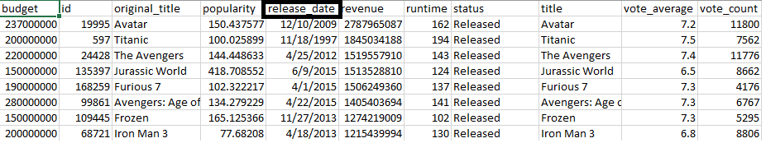
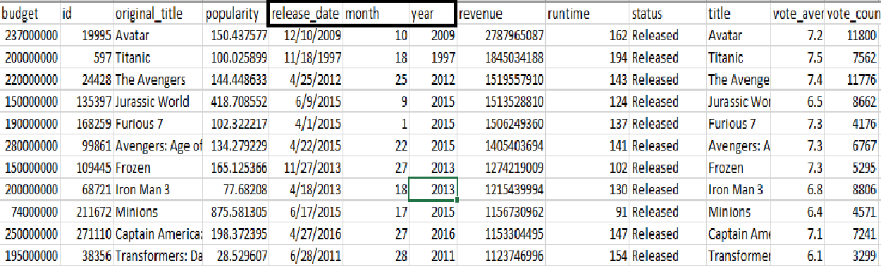
Another challenge we deal with is to separate the release date to year the movies were released
before
after

Slide 6
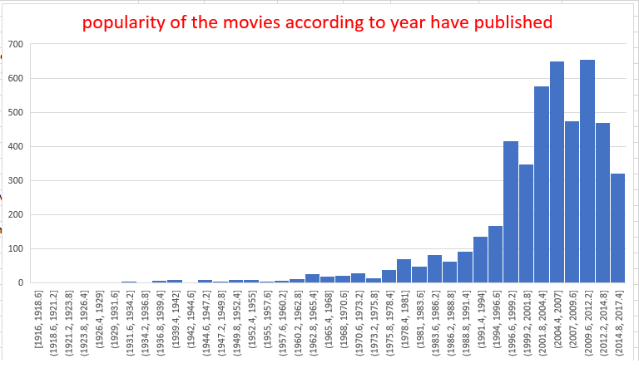
Movie's years released

Slide 7
Here we can see the run time and the revenue of each movie, so we choose 130 min in run time and 90 Mil in revenue because its somewhere in the middle.

Slide 8
We can see here the popularity of the movies and choose who has 30 and above will be consider as successful. Budget that we choose is 40 Million because it is the average.

Slide 9

The six algorithms we chose to use in the data set analysis:
KNN
Decision Tree
Logistic Regression
SVM
ADABOOST

Slide 10
Result for runtime only :
KNN:
0.740553705245629
DecisionTree:
0.7340133222314738
LogisticRegression:
0.7041923397169028
ADABOOST:
0.7968776019983346
SVM:
0.7801124063280602

Slide 11
Result for revenue only :
KNN
0.8559408825978353
DecisionTree
0.8436386344712739
LogisticRegression
0.3982223147377184
ADABOOST
0.8797418817651955
SVM:
0.8347502081598671

Slide 12
Result for popularity only :
KNN
0.8229725228975856
DecisionTree
0.9160074937552036
LogisticRegression
0.6620899250624481
ADABOOST
0.93992506244796
SVM:
0.847656119900083

Slide 13
Result for budget only :
KNN
0.8067194004995834
DecisionTree
0.7950374687760196
LogisticRegression
0.5256078268109908
ADABOOST
0.8459741881765196
SVM:
0.8382805995004163

Slide 14
Result for vote average & revenue :
KNN
0.854741881765196
DecisionTree
0.8589508742714402
LogisticRegression
0.7398251457119067
ADABOOST
0.8918068276436303
SVM:
0.8542880932556203

Slide 15
Conclusion
After running the all algorithms we choose ,the best algorithm which gave us the best results between all kinds of classifications we made is adaboost (0.87 avg) and the most ineffective algorithm is LogisticRegression (0.608 avg).
The classification which was the easiest to work with is for popularity (0.84).
The techniques that work well are adaboost, svm and decision tree with highest scores.

